Slide 1
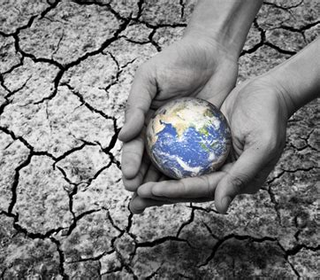
Water Scarcity – Page 1
Imagine a world where clean water isn't just a turn of a tap away. This is a real problem for many people, and it's called water scarcity. Just think, instead of playing, some kids have to spend hours each day walking to collect water that may not even be safe to drink! Water scarcity can happen because it doesn't rain enough, because water gets dirty and can't be used, or because there are too many people and not enough water to go around. It's like trying to share a small water bottle among a whole soccer team!
What does ‘water scarcity’ mean? ___________________________________________________________________
What are some reasons why water scarcity happens? ___________________________________________________________________
What does it mean when water is not safe to drink? ___________________________________________________________________ ___________________________________________________________________
Water scarcity comes in two main flavours: physical and economic. Physical water scarcity is when there's just not enough water, like in a desert or during a big drought. Economic water scarcity is when people can't get to the water that's there because they don't have enough money or the right tools. It's kind of like seeing a giant ice cream sundae on the other side of a tall glass wall. You know it's there, but you just can't get to it!
What’s the difference between physical and economic water scarcity? ___________________________________________________________________
Can you think of a place where there might be physical water scarcity? ___________________________________________________________________
How might economic water scarcity feel? ___________________________________________________________________

Slide 2
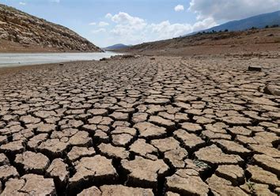
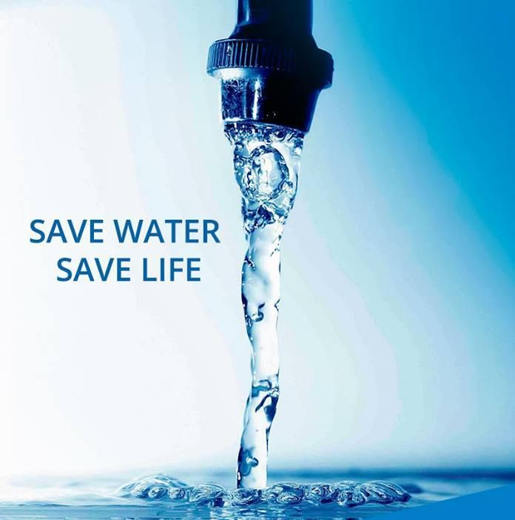
Water Scarcity – Page 2
When there's not enough water, things can get really tricky. Without clean water, we can't stay clean ourselves, and that can lead to getting sick. Imagine not being able to grow your favourite foods because there's not enough water. Also, animals and plants need water just like we do, so they can struggle and even disappear when water is scarce. It's like trying to have a garden without any rain!
What can happen to people when there isn’t enough clean water? __________________________________________________________________
Why is it important to have enough water for growing food? __________________________________________________________________
How does water scarcity affect animals and plants? __________________________________________________________________
Water scarcity sounds really tough, but don't worry, there are ways to tackle it! We can do things like saving water when we brush our teeth or taking shorter showers. There are also cool gadgets that can clean dirty water or change salty seawater into drinkable water! And guess what? Learning and teaching others about why water is so precious and how to save it is a big part of the solution. Together, we can make a big splash in solving water scarcity!
What are some ways you can save water at home? __________________________________________________________________
Can you name a cool gadget that can help solve water scarcity? __________________________________________________________________
How can learning and teaching others help solve water scarcity? __________________________________________________________________

